Slide 1
Protein regression experiment
Chao Fang

Slide 2
Unlabeled data: raw, PCA recovery, and difference

Slide 3
UnlabeledData after PCA

Slide 4
Use unlabeledData to train SAE
Train the optimal theta and then use labeled data to feed forward to get their SAEFeatures

Slide 5
Use Neural network tool box to do regression on consensus scores
70% train,15% validation, 15% testing
21 proteins

Slide 6
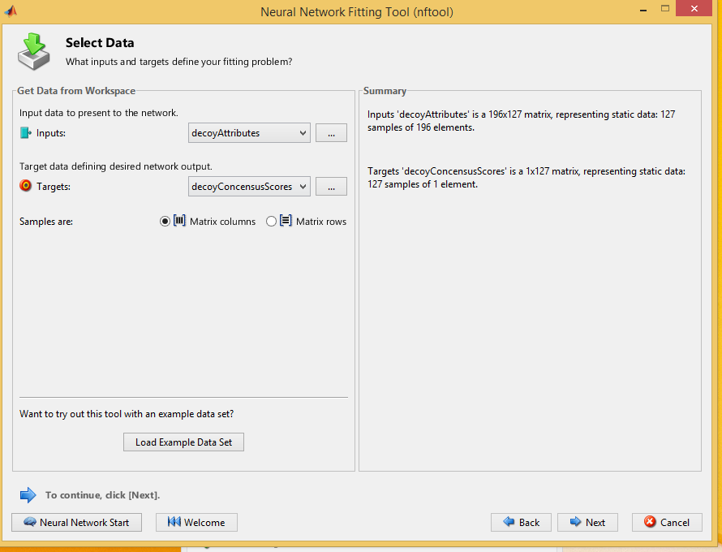

Slide 7
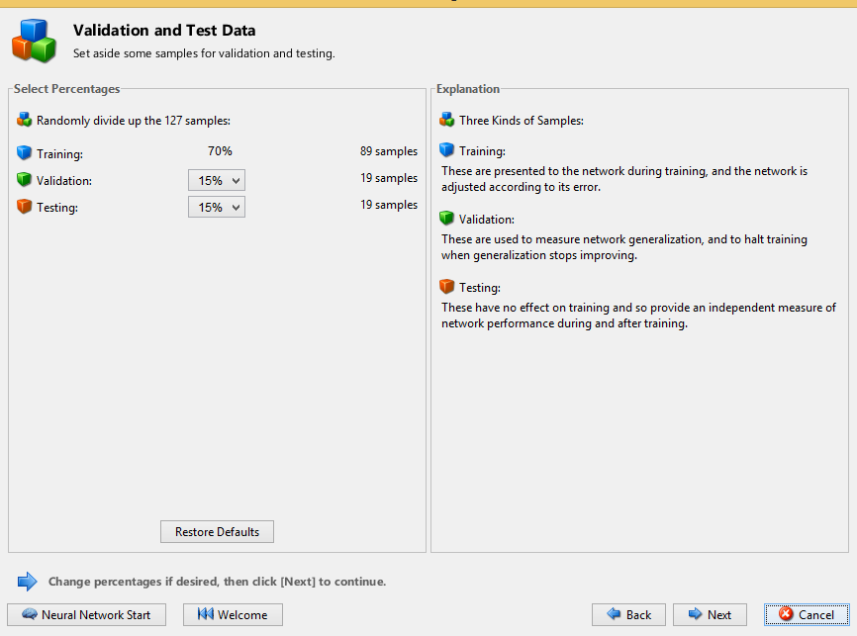

Slide 8
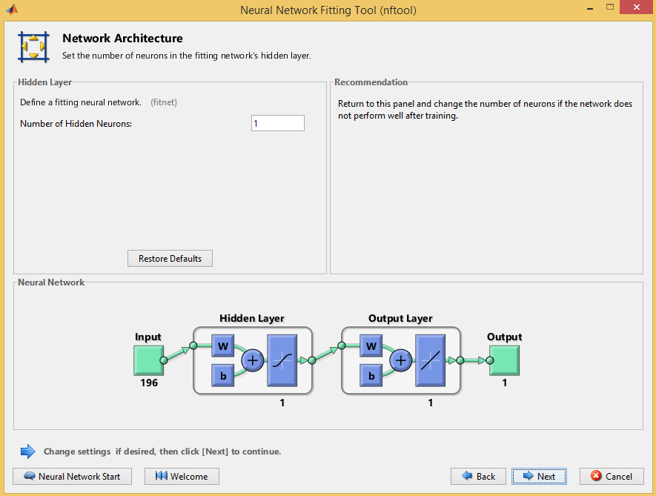

Slide 9
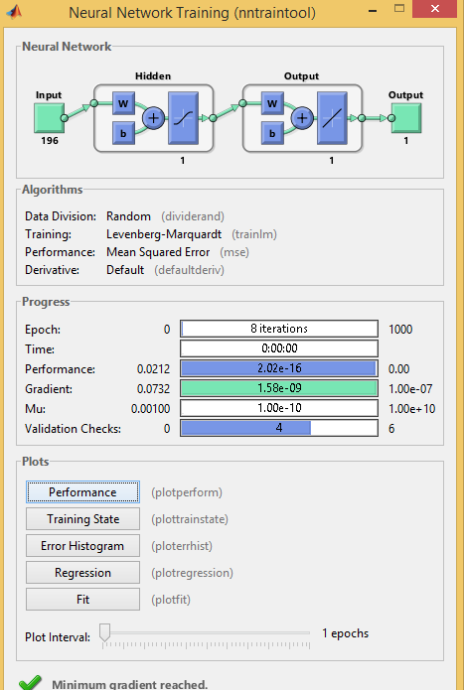

Slide 10
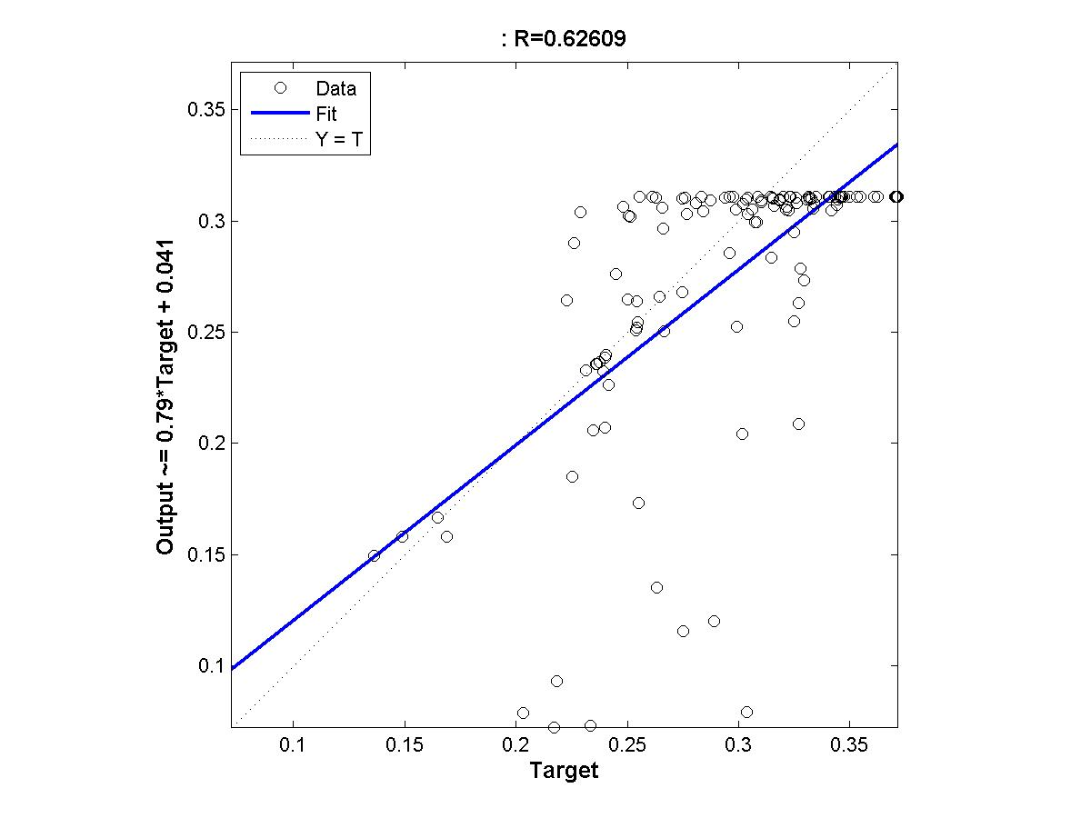
Protein 1

Slide 11
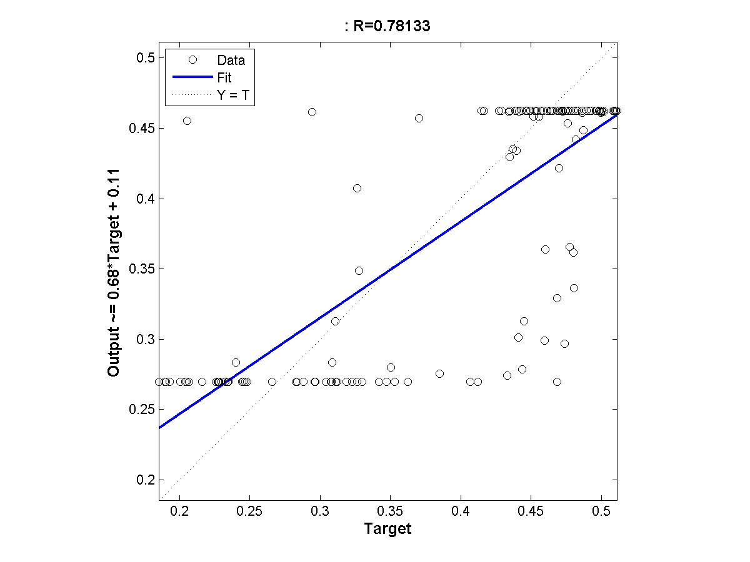
Protein 2

Slide 12
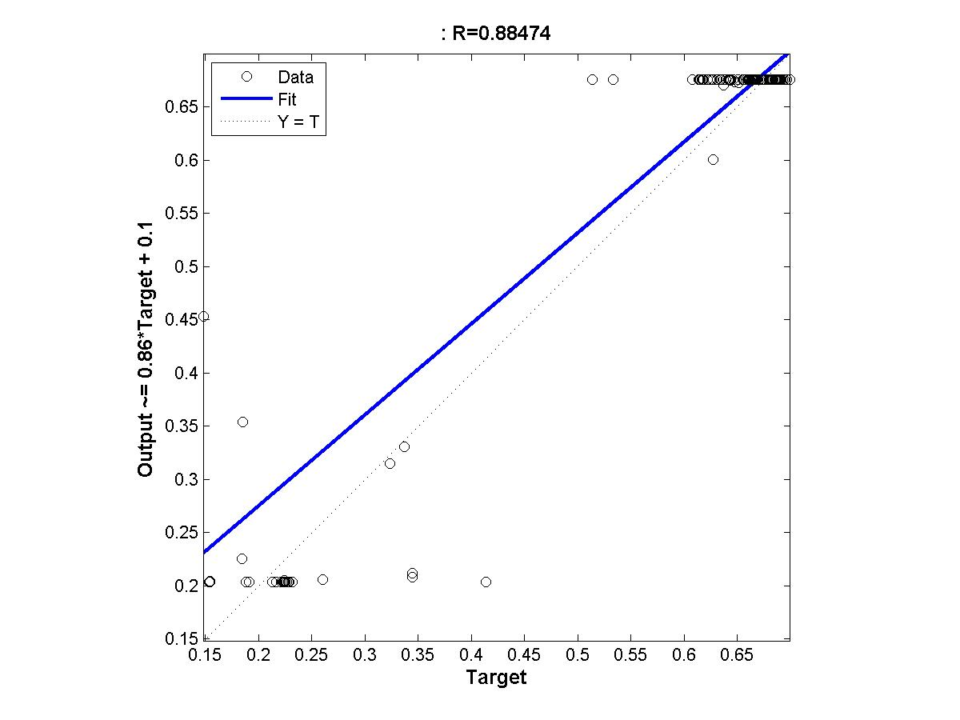
Protein 3

Slide 13
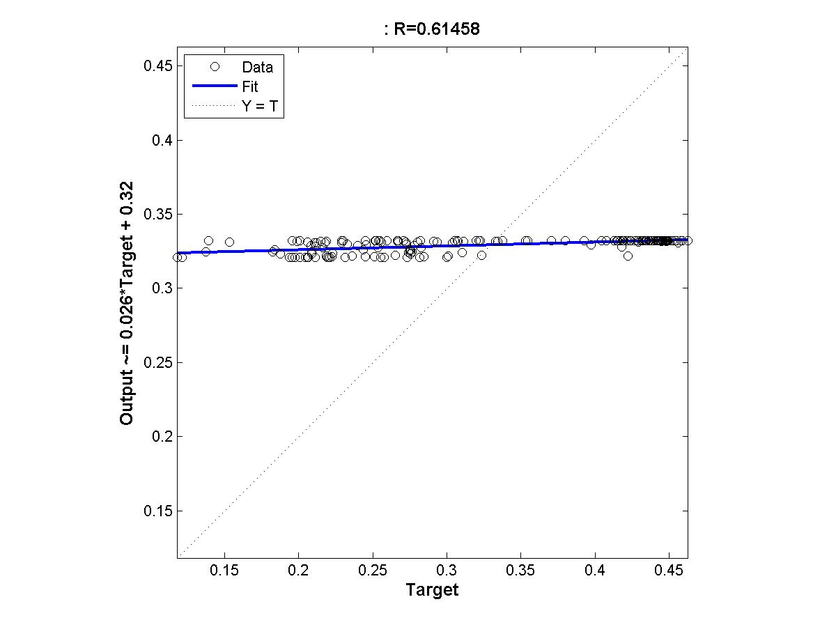
Protein 4

Slide 14
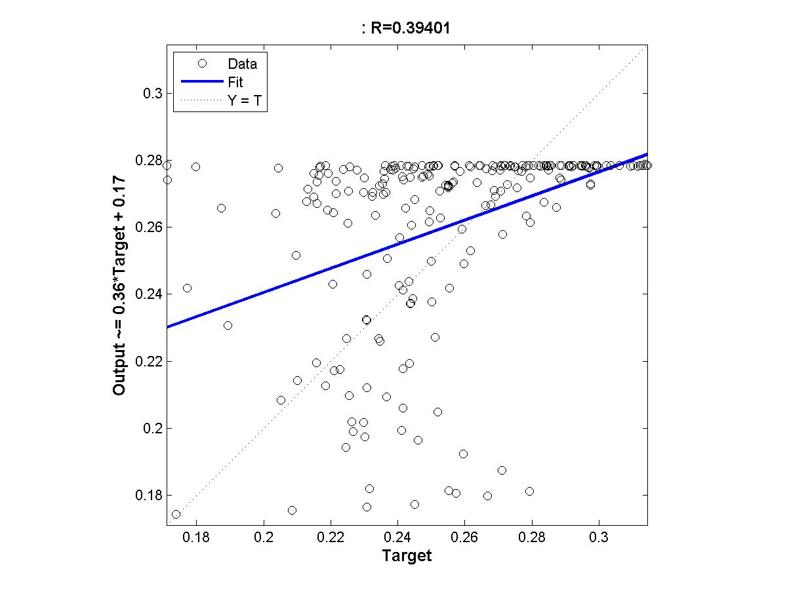
Protein 5

